Slide 1
TAKEN MINDS GLOBAL DATA ANALYTICS INTERNSHIP
PROOF OF CONCEPT -EMPLOYEE ATTRITION PROJECT DATASET

Slide 2
EMPLOYEE ATTRITION CONTROL PROOF OF CONCEPT ANALYSIS
NAME-RISHABH KAPOOR
COUNTRY-INDIA
LINKEDIN ID:- https://www.linkedin.com/in/rishabh-kapoor-b9629333/
Email-id:- Kapoor.rishabh88@gmail.com
Project:- Company’s Employee Attrition Case

Slide 3
PROBLEM STATEMENT
The dataset is for a company who is trying to control attrition.
Two sets of data is there one is “Existing employees” and the other is “Employees who have left”
Attributes are there common for every employee as:
Satisfaction Level
Last Evaluation
Number of projects
Average monthly hours
Time spent
Work Accident
Promotion in last 5 yrs
Department(column sales)
Salary
Whether employee has left

Slide 4
OBJECTIVE-We have to Formulate a methodology and technique in answering the following questions
What type of employees are leaving?
Which employees are prone to leave next?

Slide 5
METHODOLOGY USED
In order to provide better insights and inferences we adopt exploratory Data Analysis (EDA) in this Employee Attrition problem which comprises of-
1.Uni-variate Analysis-In this analysis we compare “existing employees” individual features or variables with the “employees who left the company” data individual features or variables and visualize in form of bar graph and make inferences or insights from there.
2. Bi-variate Analysis- In this one we compare “existing employees” two or more features with the “employees who left the company” two or more features and visualize in form of heat maps and box plots and make insights from there .

Slide 6
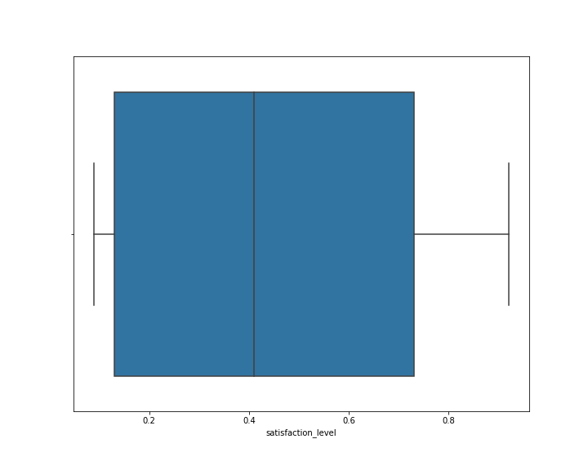
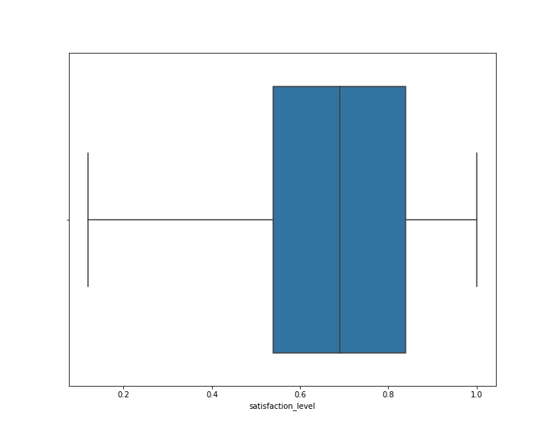
CHART-1 UNIVARIATE ANALYSIS
SATISFACTION LEVEL OF EMPLOYEE THAT LEFT
SATISFACTION LEVEL OF EXISTING EMPLOYEE

Slide 7
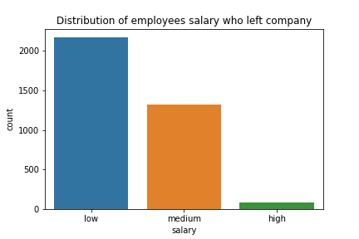
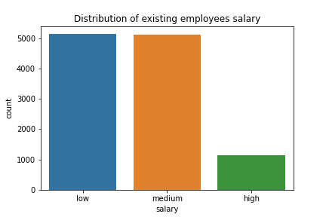
CHART-2 UNIVARIATE ANALYSIS

Slide 8
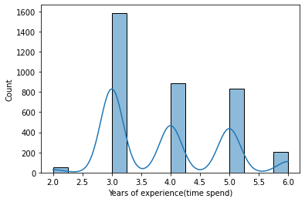
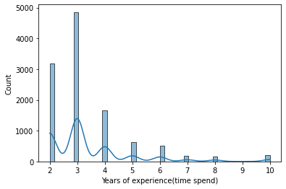
CHART-3 UNIVARIATE ANALYSIS
Years of experience of employee left
Years of experience of existing employees

Slide 9
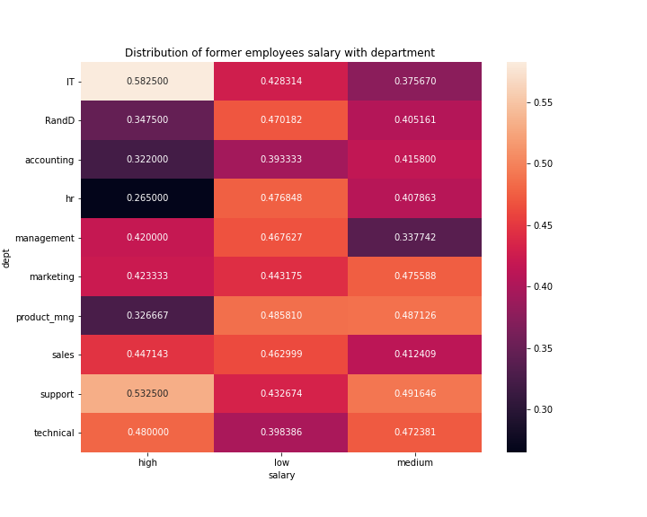
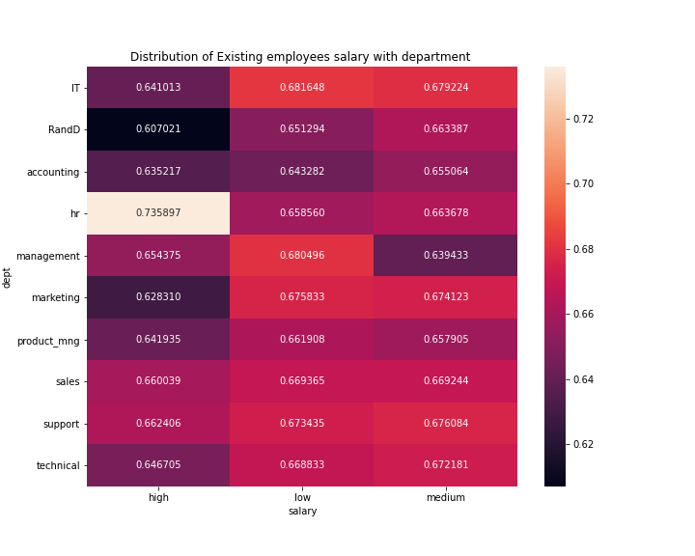
CHART-4 BIVARIATE ANALYSIS

Slide 10
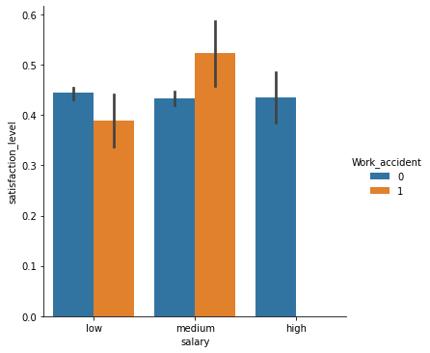
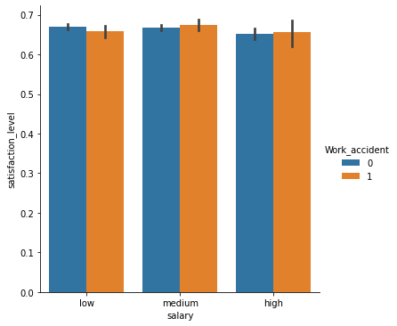
CHART-5 BIVARIATE ANALYSIS
Satisfaction level of Employee left on basis of work accidents and salary impact
Satisfaction level of Existing Employees on basis of work accidents and salary impact

Slide 11
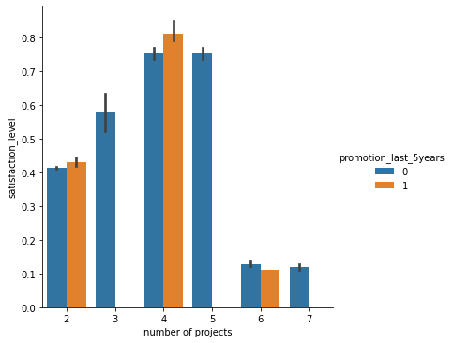
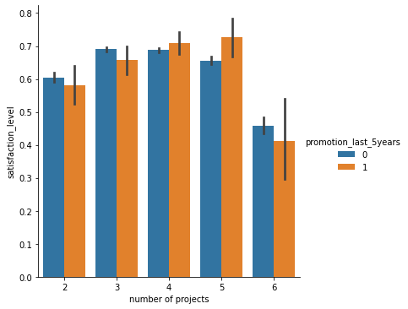
CHART-6 BIVARIATE ANALYSIS
Satisfaction level of employee left on basis of number of projects and promotion
Satisfaction level of Existing employees on basis of number of projects and promotion

Slide 12
OBSERVATIONS AND INSIGHTS ACHIEVED
As by observing from Chart-1 satisfaction level of former employees i.e. employees who left has approximately 45% and satisfaction level of existing employees has approximately around 70% .
By taking insights from Chart-1 ,we infer that satisfaction level is one of the key drivers for retention of a particular employee as in case of employees who left most of the employees around 60% has a satisfaction level below the average satisfaction level of 45% and in case of Existing employees less than 10 % has a satisfaction level below the average of 45% .
So my recommendation is to increase the satisfaction level of existing employees.

Slide 13
OBSERVATIONS AND INSIGHTS CONTINUED
By further deep diving to why we want to increase satisfaction level of exisiting employees I will let you deep dive into analysis of Chart-2 in which I observed that majority of lower income group salary people have left the organization ,and in case of Existing employees Middle income and low income individuals are more in our organization.
So by this we conclude that those existing employees who has satisfaction level below 45% are mostly in low and middle income group.
By further analysing Chart-5 We infer that for employee who leaves salary structure is around 50% and accident during work impacts on the satisfaction level for lower income and middle income group people and whereas for existing employees there is a uniform structure of salary for low,middle and higher income groups and satisfaction level is also better here.

Slide 14
OBSERVATIONS AND INSIGHTS CONTINUED
By taking insights from Chart-6 we analyze that number of projects as they increased satisfaction level of employees who left has considerably fallen as compared to the existing employees.
Also from chart-6 we see that Promotion in last 5 years has not happened for senior folks means exp>4 this is also the key factor of leaving the company as satisfaction level is gradually decreased whereas For existing employees promotion in last 5 years is uniform almost for all individuals of all experiences.
From chart-3 and Chart-4 we infer that a amalgamation of junior and senior folks are there who have left the organization whereas young employees are there mostly in the existing scenario and also HR & Management dept which has lowest Salary structures previously has the highest of all salaries in existing scenarios.

Slide 15
RECOMMENDATION AND FINDINGS
So As per my findings , Firstly I recommend company must improve the satisfaction level by promoting senior folks in the organization and increasing the salary structure department wise.
Secondly Allotting least number of projects to an employee is also the determining factor for employee retention.As Number of projects allotted is inversely proportional to Satisfaction Score of employee.
Also Satisfaction score is directly proportional to Salary as increasing the salary structure which I have mentioned earlier dept wise in a periodic manner also increase the confidence of the employee and he will not attrite from his/her job.

Slide 16

So,Thankyou Taken minds for Providing me such a wonderful opportunity to enhance my Data Analytics capabilities
.

